Slide 1
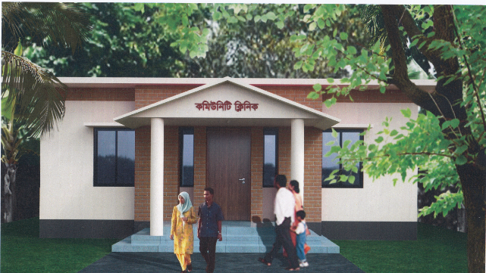
Citizens’ Satisfaction of Community Clinic

Slide 2
Supervised by:
Mohammad Shahjahan Chowdhury
Professor
Department of Public Administration
SUST, Sylhet
Presented by:
Abdullah Al Malek Chowdhury
Reg.2020237016
3rd Year 2nd Semester
Public Administration, SUST

Slide 3
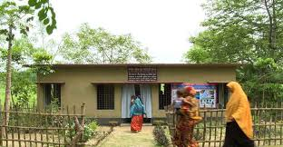
Background
The community clinic initiative in Bangladesh is a pioneering model for delivering primary healthcare to rural and underserved areas.
Launched : In 1998
Number of Community Clinic : 13094
One Community Clinic for 6000 people
Healthcare Services:
Maternal and child health
Immunization
Family planning
Nutrition
Treatment of common illnesses.

Slide 4
Objective of the study
4
To evaluate public perceptions on community clinic services.
To identify factors influencing citizen satisfaction.
To provide actionable recommendations for improvement.

Slide 5
Research Methodology
Approach: A qualitative Content Analysis
Initial Consideration
Identification of data
Creating Codes
Creating a coding framework
Reliability and Credibility check
Analyze the result

Slide 6
Findings
Timing
Accessibility
Service Quality
Cleanliness
Skill of Service Providers
Patient staff interaction

Slide 7
Result and Discussion
Code | frequency
Timing | 9
Accessibility | 5
Quality of service | 7
Cleanliness | 8
Skill of service provider | 7
Patient interaction | 7
Table 1 : Codes and frequency

Slide 8
Result and Discussion
Division | Immunization | Vitamin A | General healthcare of children | Child growth monitoring
Barisal | 14.1 | 11.1 | 12.5 | 20
Chittagong | 13.1 | 17.1 | 11.8 | -
Dhaka | 8.6 | - | 9.50 | -
Khulna | 23.4 | 45.5 | 17.8 | 40.0
Raj Shahi | 10.3 | 2.90 | 16.0 | 10.0
Rangpur | 27.5 | 16.0 | 24.1 | 30.0
Table2: Division-wise proportion usage of community clinic services

Slide 9
Recommendations
Enhance Accessibility
Improve quality of care
Foster positive staff-patient interaction
Upgrade Infrastructure

Slide 10

Thank You

